Slide 1



WorkStream – Smart Project Management
Milestone 1 Update HYDRA DEVS
An overview of the progress made by Hydra Devs in the WorkStream project.

Slide 2

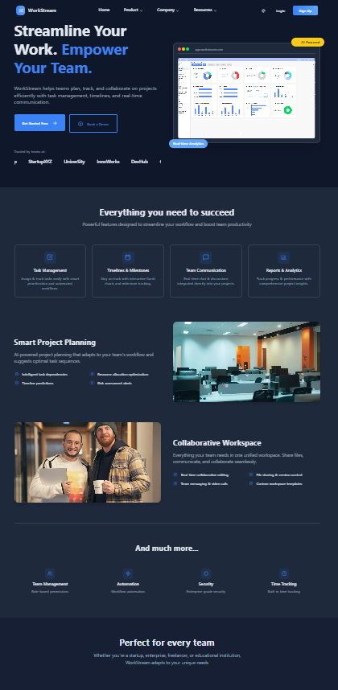
Project Overview
WorkStream: The Ultimate Solution for Task and Team Management in One Platform
WorkStream is designed to enhance team collaboration and productivity through efficient task management.
By integrating timelines, file sharing, and communication tools, WorkStream enables teams to work seamlessly, ensuring that all project aspects are easily accessible and manageable from one central hub.
2

Slide 3
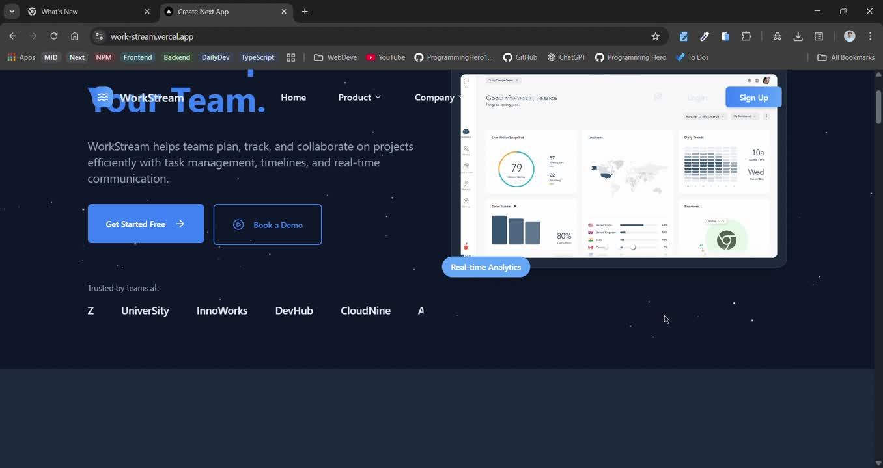

Slide 4

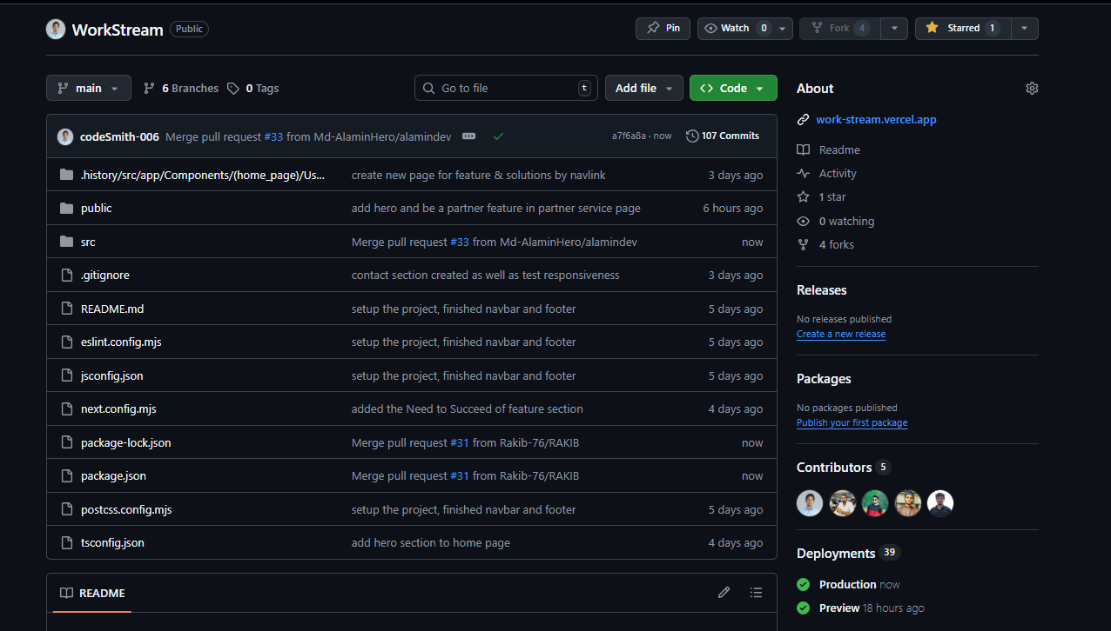
REHAN ISLAM
Team Leader Contributions
Set up the project repository and maintained Git collaboration
Distributed tasks and tracked team progress daily
Handled the deployment side of the project
Developed the Navbar, Footer, and Dark Theme Toggle
Planned the Authentication page layout
Worked on the SRS document
4

Slide 5
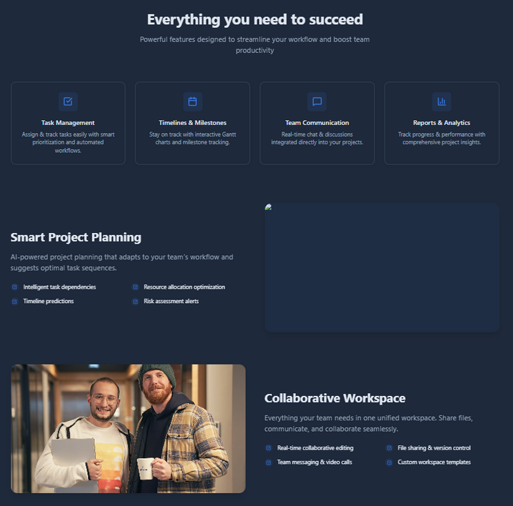
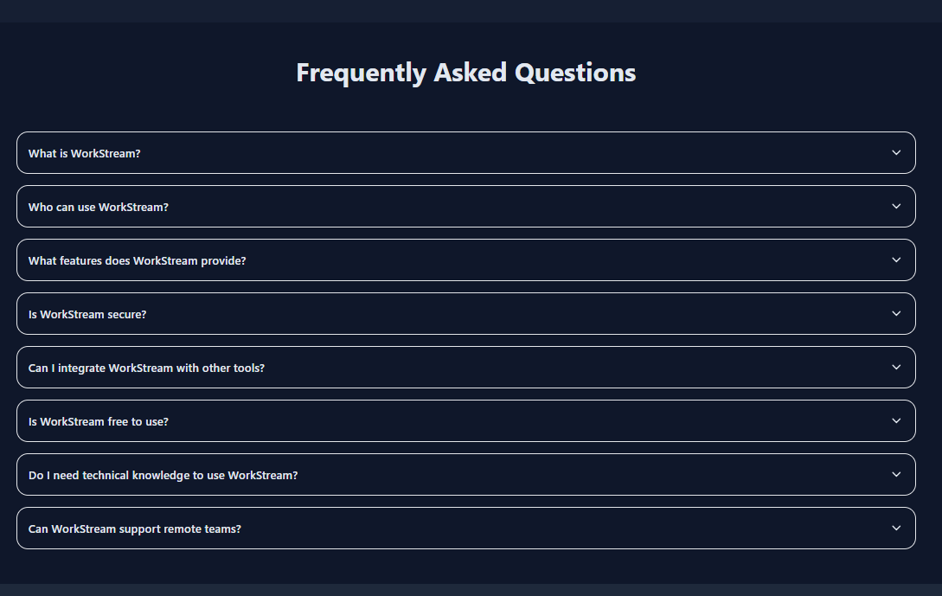
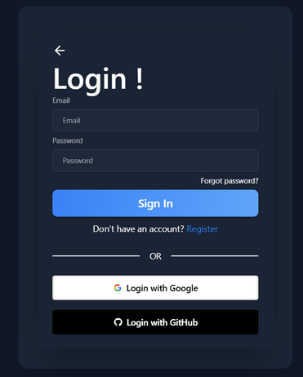
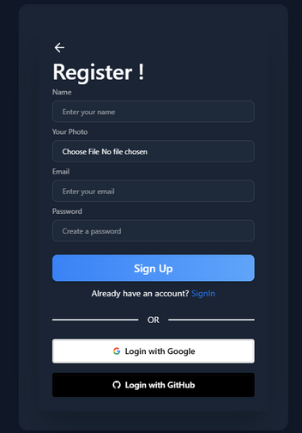
Set up the project repository and maintained Git collaboration
Distributed tasks and tracked team progress daily
Handled the deployment side of the project
Developed the Navbar, Footer, and Dark Theme Toggle
Planned the Authentication page layout
Worked on the SRS document
Contributions of Md Rakib Hasan
5

Slide 6
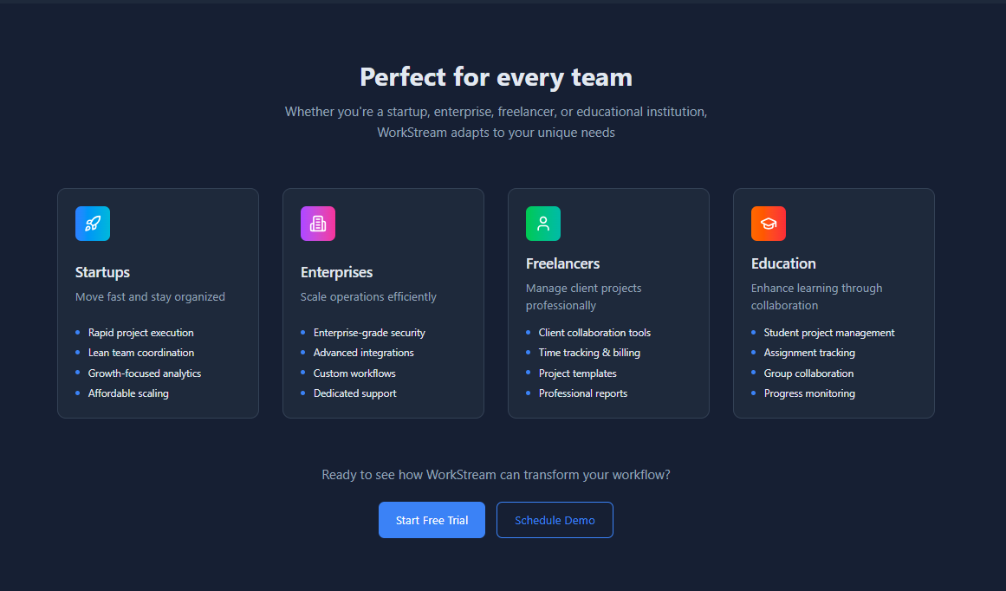
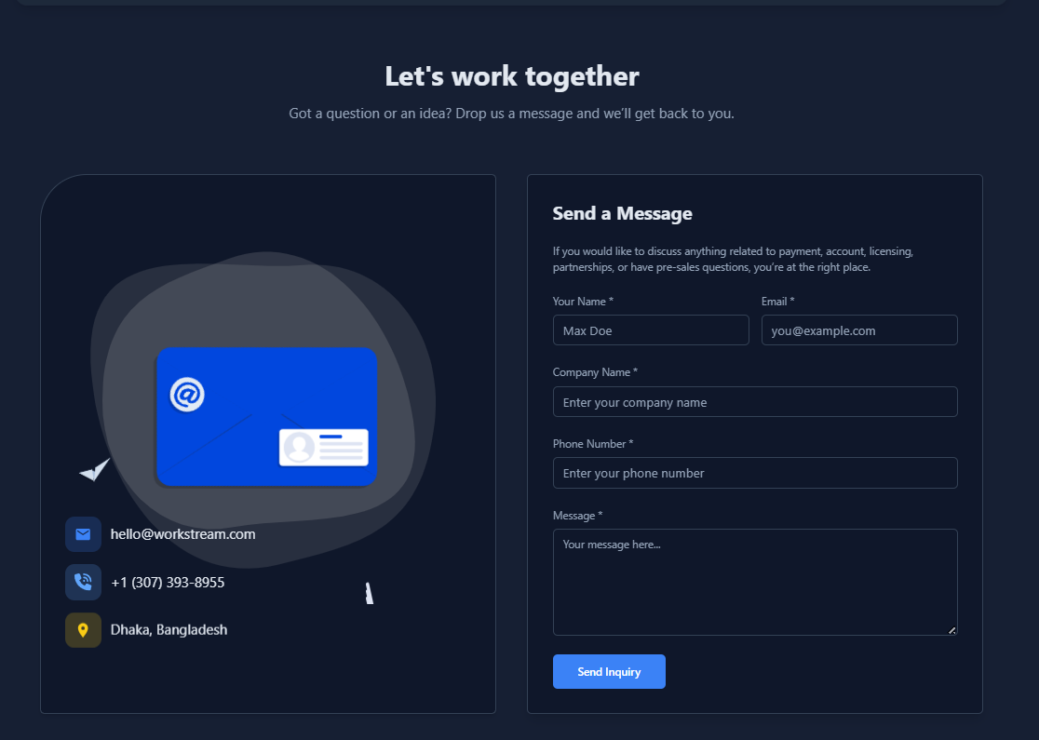
Designed the Use Cases section (Perfect for Every Team)
Built the Contact section (Let’s Work Together)
Created the Community section
Implemented Lottie animations in the Authentication page
Added animations using Framer Motion and AOS to the homepage
Contributions of Syed Bayzid
6

Slide 7
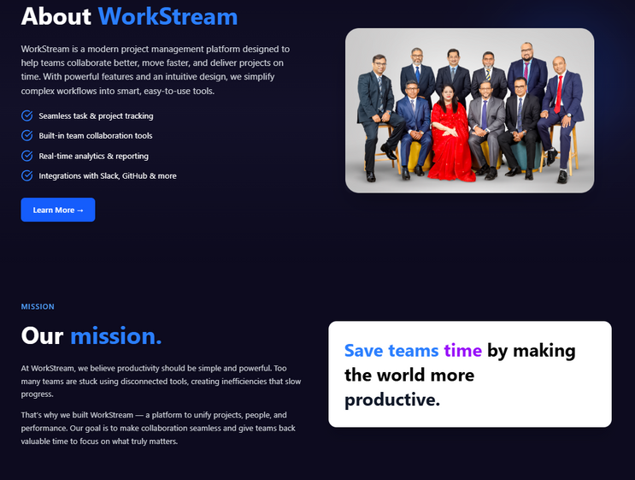
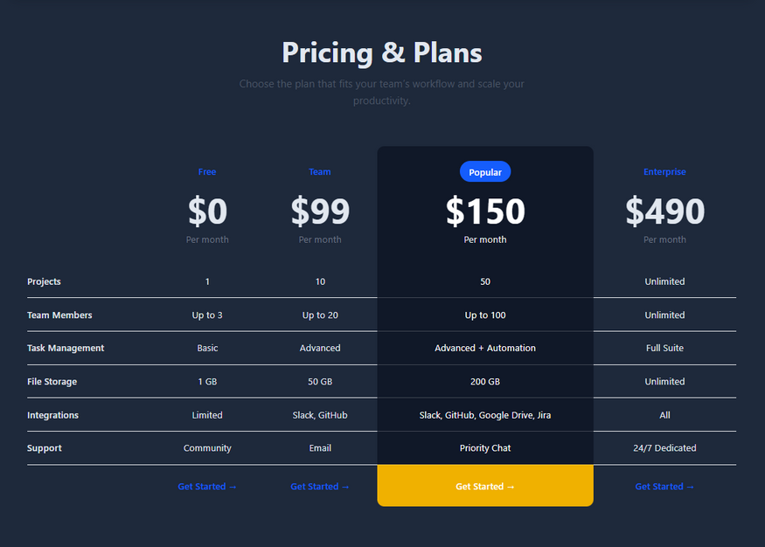

Designed the About Page with theme toggle, animations, and responsive design
Built the Pricing Page with multi-plan table and highlighted “Popular” plan
Created the Partners Page with carousel and animated stats cards
Developed the Help & Support Page with interactive form and file upload
Enhanced the Footer with dynamic links for Product, Company, Resources, and Legal
Contributions of Ashfaq Sarker
7

Slide 8
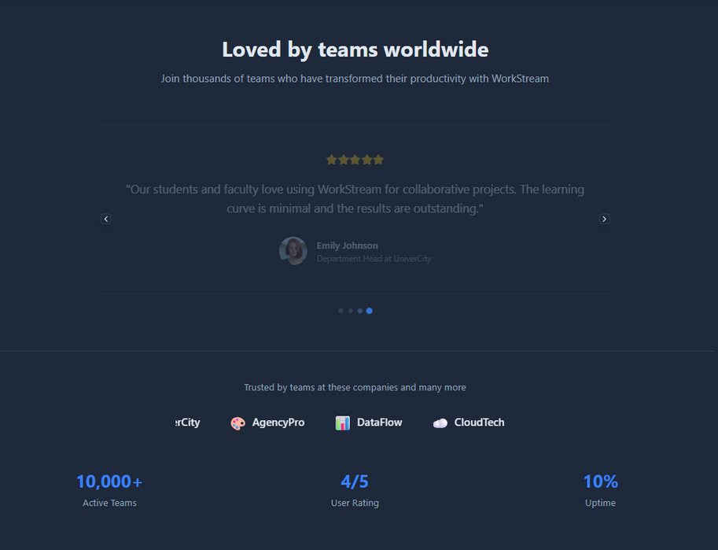
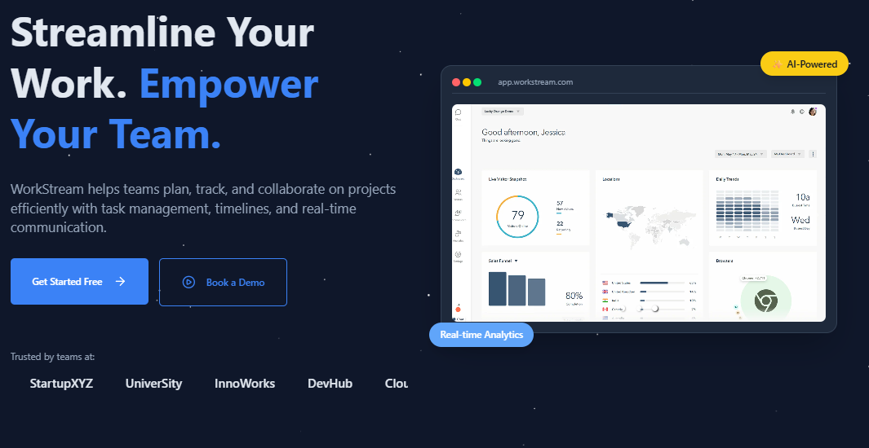
Md Al Amin's Contributions
Added Testimonials section
Added hero section
Implemented Count animations
Added Slider animations
Added Lottie animations in the Authentication page
8

